Slide 1
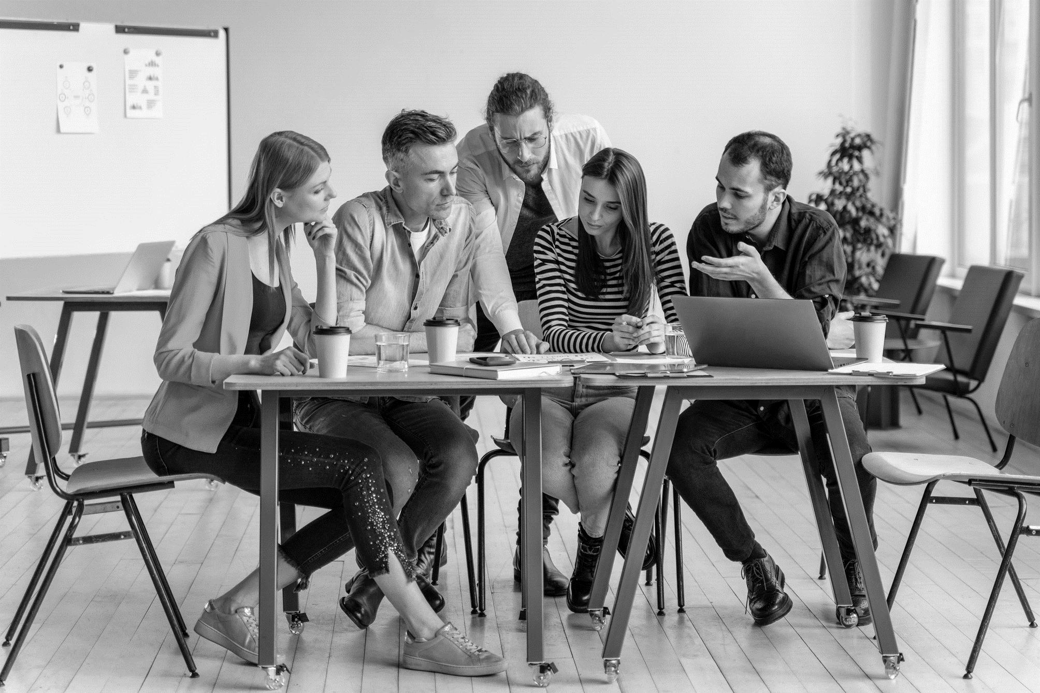
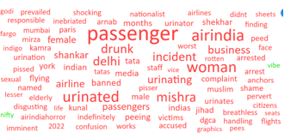
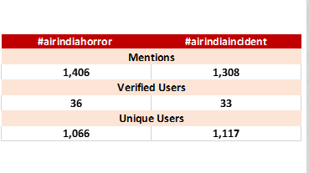
CRISIS MONITORING: WANTED TO REDUCE THE NEGATIVE SENTIMENTS – Air India
GOAL:
To monitor the conversations around on-board urination incidents and POV of the public
SOLUTION:
Case study
The team continuously monitored the buzz and identified the POV of the audience further suggested to the brand to take action accordingly also penned down the expectations of the audience from the brand
Benefit:
This helped the brand in reducing the negative chatter around and uplifted the overall positive sentiments

Slide 2
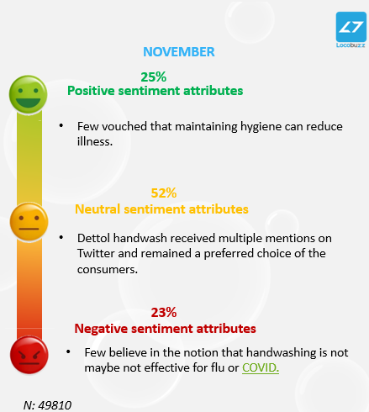
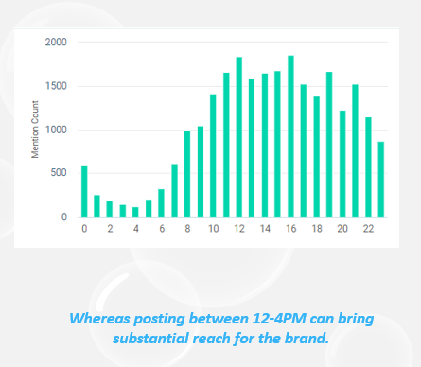
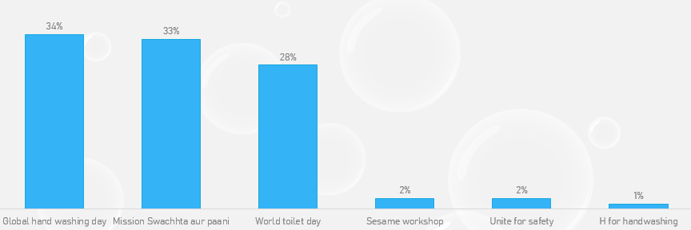
HYGIENE PRACTICES: TO DEVELOP CONTENT & COMMERCIAL VIDEOS AROUND HYGIENE PRACTICES
GOAL:
To understand the current hygiene practices of children & their caregivers and to develop the social media content & campaign around the same
SOLUTION:
Case study
The Locobuzz team worked to identify the hygiene themes that worked great on social & suggested new campaign ideas that can influence the parents/caregivers & in turn can raise the4 bar of hygiene knowledge
Benefit:
Identification of the right kind of content resonating, with the potential segments, & the regions. Also helped them in understanding what the giants are doing around hygiene practices for building the better image

Slide 3
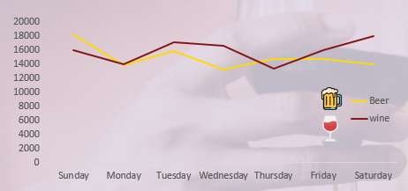
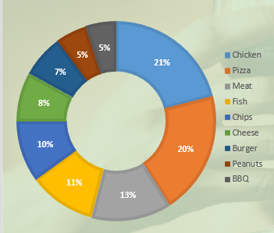
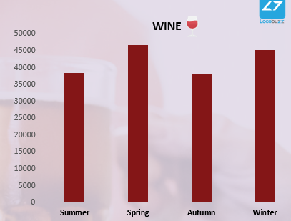
BEER VS WINE: TO UNDERSTAND HOW THEY COMPETE
GOAL:
To understand how beer and wine compete across seasons and occasions
SOLUTION:
Case study
The report highlighted the seasonal & occasional trends of beer vs wine. Moreover, it suggested the top preferred food items get paired with beer & wine
Benefit:
Such analysis can help marketers to pin point the growth the beer & wine basis the time of the year & occasion. Further, this understanding can help the brands to advertise their products more wisely to tap the drinkers

Slide 4
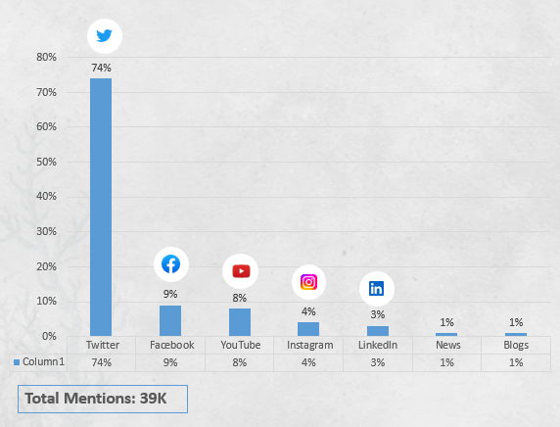
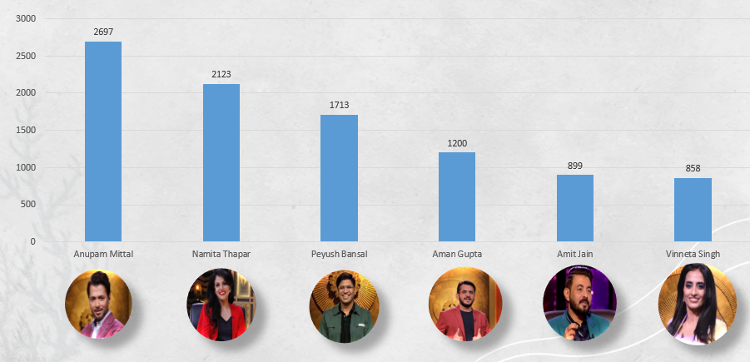
SHARK TANK S2: TO CAPTURE THE MARKET BUZZ
GOAL:
To understand the market buzz around the Shark Tank India S2 and key voices around the sharks
SOLUTION:
Case study
The report highlighted the most-loved shark and the reasons behind it further it showcased the themes which received negative conversations. And comparison from season 1 and the reasons henceforth
Benefit:
Such analysis can help entertainment players to focus on the areas which received negative remarks. Moreover, this can help the sharks to understand their social personals and what went well and what not, to better prepare for the next season

Slide 5
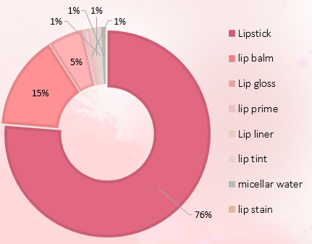
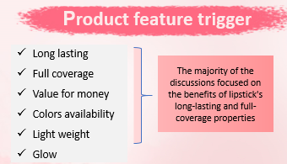
LIP CATEGORY ANALYSIS: TO IDENTIFY SOCIAL CONVERSATIONS
GOAL:
Understanding the social conversations around the lip category
SOLUTION:
Case study
The analysis identified the top lip products category to focus on, further suggested the features that users looking for and the key barriers besides any non-preference
Benefit:
Such analysis can help brands to play smartly around the applications and features of lipstick. Moreover, can help in developing the content strategy to tap the conscious consumers and to lead the market share

